Slide 1
Digital Portfolio
STUDENT NAME: S.ABINAYA
REGISTER NO AND NMID:
DEPARTMENT: COMPUTER SCIENCE
COLLEGE: E.S ARTS AND SCIENCE COLLEGE , ANNAMALAI UNIVERSITY

Slide 2
PROJECT TITLE
Quiz Application
A web-based interactive quiz system with HTML, CSS, and JavaScript.

Slide 3


AGENDA
Problem Statement
Project Overview
End Users
Tools and Technologies
Portfolio design and Layout
Features and Functionality
Results and Screenshots
Conclusion
Github Link
3/21/2024 Annual Review

Slide 4

PROBLEM STATEMENT
Students often lack interactive learning tools for Artificial Intelligence.
Traditional quizzes are static, paper-based, or unengaging, offering little instant feedback.
Lack of motivation and interactivity leads to reduced learning efficiency.
There is a need for a lightweight, browser-based quiz application that provides instant results and engaging UI.

Slide 5

PROJECT OVERVIEW
The AI Quiz App is a simple, user-friendly platform to practice AI knowledge.
Students enter their Name and Register Number before starting.
The app displays 10 multiple-choice questions with four options each.
After completion, it shows the score along with a thank-you message.
Designed with a clean blue-themed interface for clarity and professionalism.

Slide 6

WHO ARE THE END USERS?
Students – To practice AI concepts in an interactive way.
Teachers – To conduct quick and engaging assessments.
Institutions – For classroom quizzes and learning modules.
Self-learners – To revise and evaluate their knowledge of AI.

Slide 7

TOOLS AND TECHNIQUES
HTML → Structures quiz content (questions, inputs, results).
CSS → Provides styling, gradients, layouts, and button designs.
JavaScript → Manages quiz logic, scoring, and interactive flow.
Browser-based → Lightweight, portable, requires no installation.

Slide 8
POTFOLIO DESIGN AND LAYOUT
User Input Page – Collects Name and Register Number.
Quiz Section – Displays one question at a time with four clear answer buttons.
Result Page – Shows Name, Register Number, score, and a thank-you note.
UI Theme – White container with blue gradient background for a professional and modern look.
Responsive Layout – Works on desktop and mobile browsers.
8

Slide 9
FEATURES AND FUNCTIONALITY
Capture student details before starting.
10 AI-based MCQs with four options each.
Dynamic scoring system to calculate results instantly.
Interactive buttons with white text and blue background for readability.
Thank-you message at the end for a professional finish.
Can be enhanced with:
Timer for each quiz.
Green/Red feedback for correct and wrong answers.
Integration with database for storing results.

Slide 10
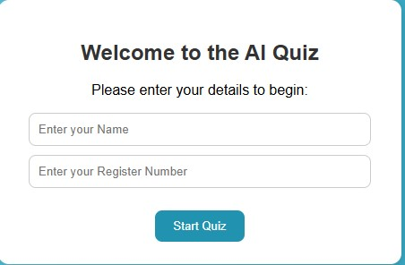
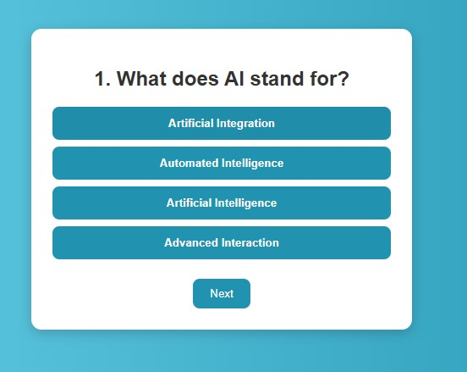

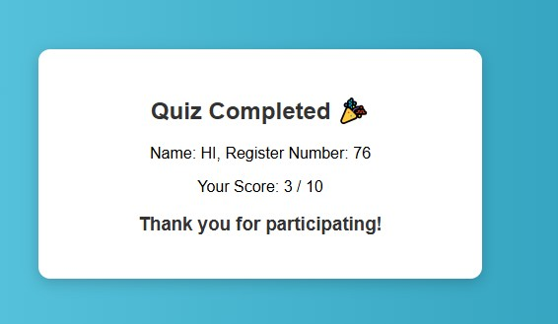
RESULTS AND SCREENSHOTS
The quiz successfully runs in a browser.
3/21/2024 Annual Review
10

Slide 11
CONCLUSION
The AI Quiz App is a lightweight, interactive, and engaging learning tool.
It enhances student participation by making assessments fun.
Provides instant feedback for better understanding of AI concepts.
Can be expanded into a full e-learning system with database integration, authentication, and advanced features.
11

